Slide 1
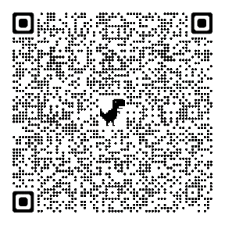
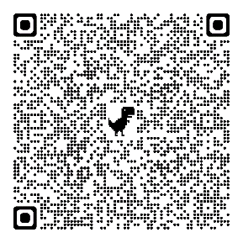
18th October 2021 at 7 pm
https://zoom.us/j/95667259004?pwd=Sjk3Yk5IOVRjWlJXdjRLVVFoUURHUT09
Meeting-ID: 956 6725 9004
Kenncode: 910998
26th October 2021 at 2 pm
https://zoom.us/j/93131315683?pwd=aWpWaWxUdmxnb0lkMU1VTGVDdjFWQT09
Kenncode: 524585
Meeting-ID: 931 3131 5683

